Slide 1
EMPLOYEE ATTRITION PREDICTION
Presented By :
Nikita Avhad (210943025006)
Bhagyashri Bhole (210943025009)
Mayur Kale (210943025020)
Raj Gholap (210943025037)
Under the guidance of :
Mr. Amey Manjrekar

Slide 2
INTRODUCTION
Employee attrition is considered a well-known problem that needs the right decisions to preserve high qualified employee.
our model evaluates the attrition risk for employees to avoid situations like resignation due to personal reasons, switching careers, lack of growth opportunities.
To investigate how the company objectives influence in attrition and what kind of working environment are likely to cause attrition. we applied machine learning algorithms on dataset to solve business problem.

Slide 3
OBJECTIVE AND SCOPE
The objective of this project is to predict the attrition rate for each employee, to find out who’s more likely to leave the organization.
It will help organization to find ways to prevent attrition or to plan in advance the hiring of new candidate.
Attrition proves to be a costly and time consuming problem for the organization and it also leads to loss of productivity.
The scope of the project extends to companies in all industries.

Slide 4
MODULES
❖ Python
❖ Apache-Spark
❖ MongoDB
❖ Machine Learning
❖ Power BI

Slide 5
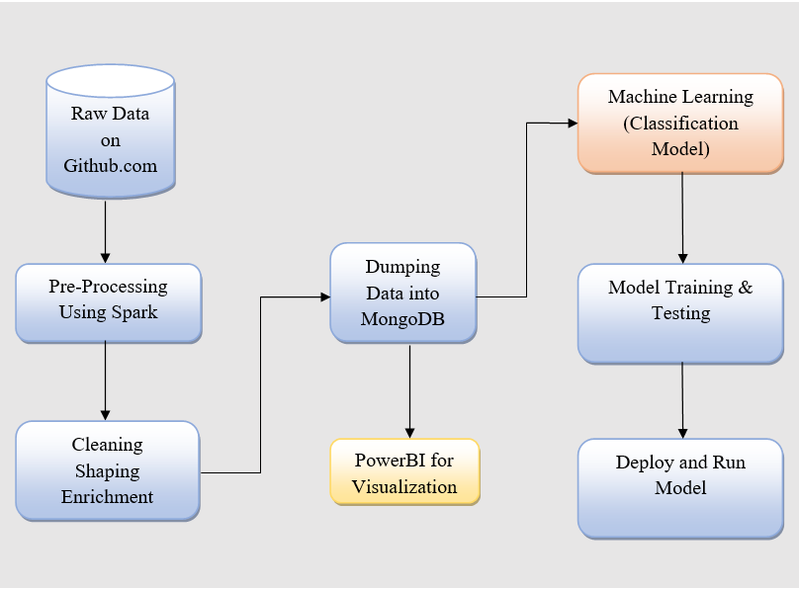
METHODOLOGY

Slide 6
ALGORITHM
Algorithm Used:
Logistic Regression
Knn Classifier
Random Forest Classifier
Voting Classifier

Slide 7
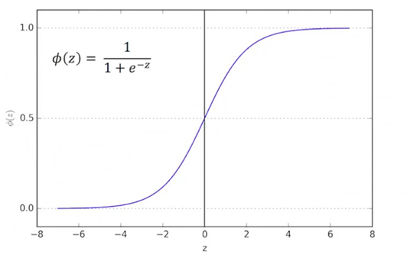
LOGISTIC REGRESSION
Logistic regression is used to describe data and to explain the relationship between one dependent binary variable and one or more independent variables.
Logistic equation is created in such a way that the output a probability value that can be mapped to classes and values can only be between 0 and 1 by using sigmoid function.

Slide 8
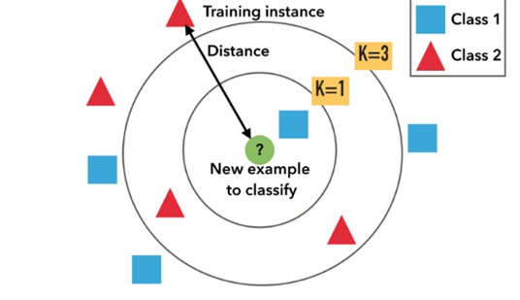
KNN CLASSIFIER
K nearest neighbors is a simple algorithm that stores all available cases and classifies new cases based on a similarity measure.
It is an approach to data classification that estimates how likely a data point is to be a member of one group or the other depending on what group the data points nearest to it are in.

Slide 9
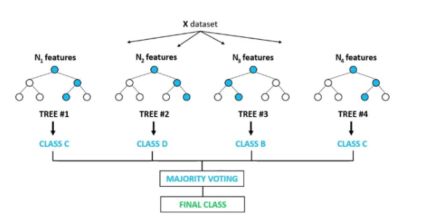
RANDOM FOREST CLASSIFIER
It creates multiple decision trees using bootstrapped datasets of the original data and randomly selecting a subset of variables at each step of the decision tree.
The model then selects the mode of all of the predictions of each decision tree.
By multiple trees it reduces the risk of error from an individual tree.

Slide 10
VOTING CLASSIFIER
It is an machine learning estimator that trains various base models or estimators and predicts on the basis of aggregating the findings of each base estimator.
The aggregating criteria can be combined decision of voting for each estimator output.
The voting criteria can be of two types:
A] Hard Voting :
Voting is calculated on the predicted output class.
B] Soft Voting :
Voting is calculated on the predicted probability of the output class.

Slide 11
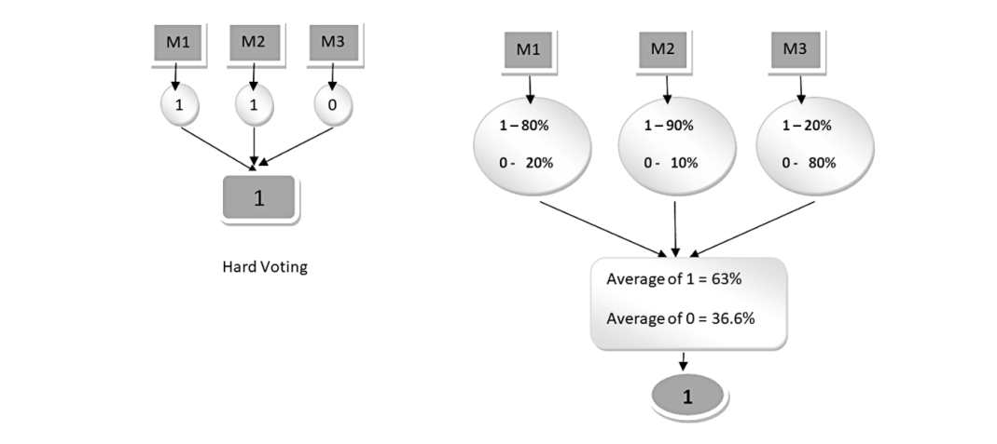
VOTING CLASSIFIER

Slide 12
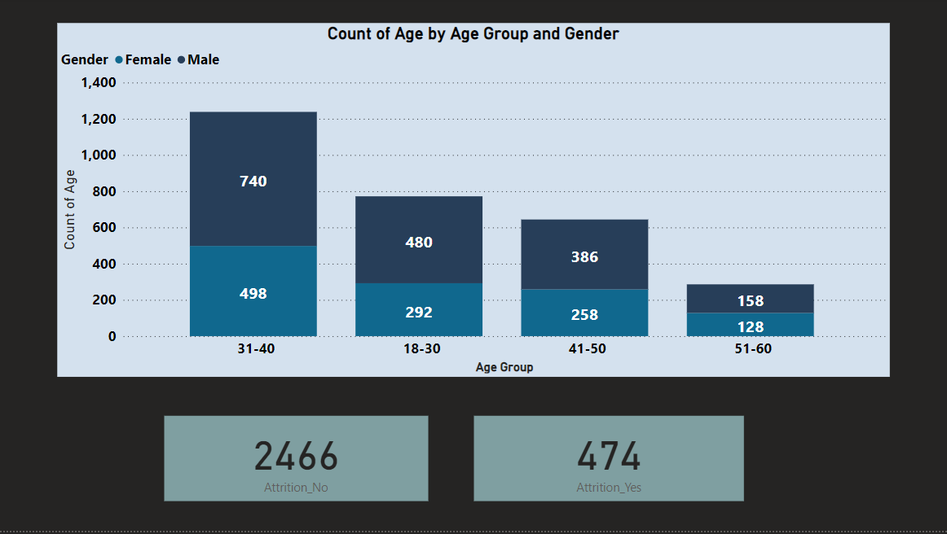
DATA VISUALIZATION
Stacked Column Chart of Attrition count by Age Group and Gender

Slide 13
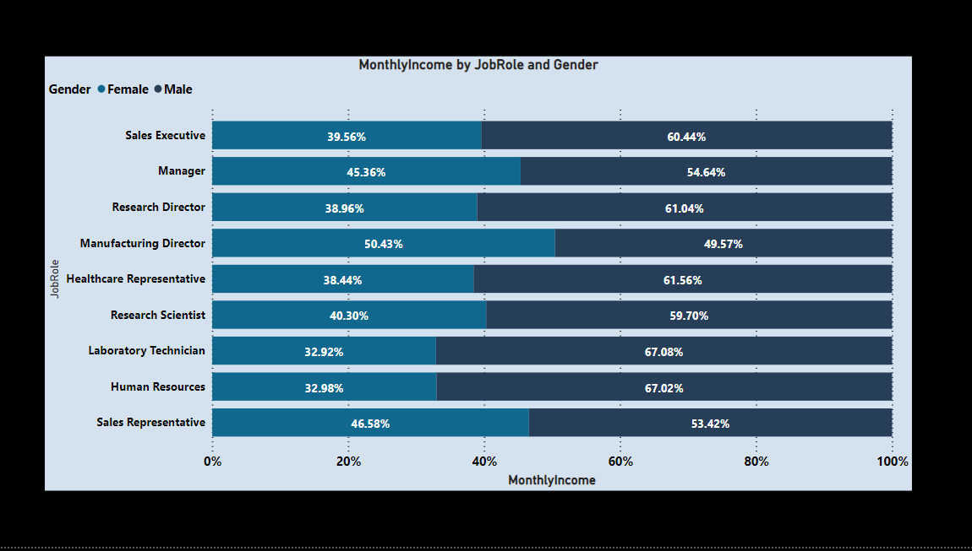
DATA VISUALIZATION

Slide 14
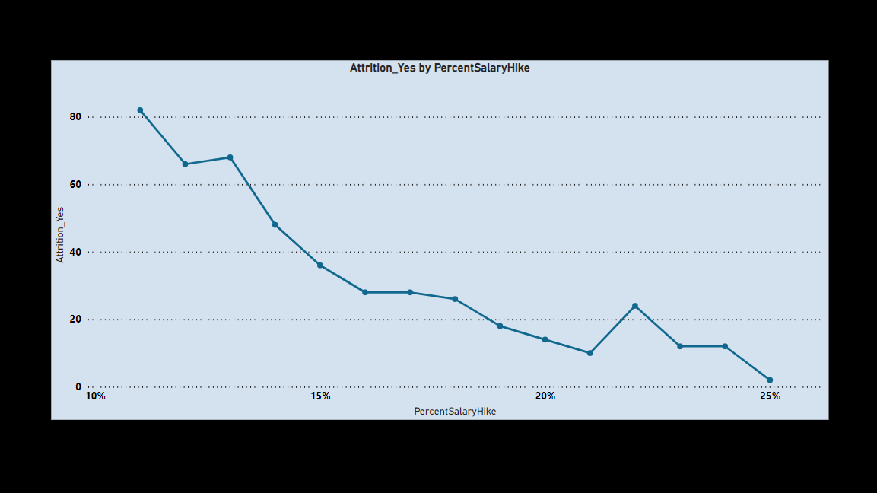
DATA VISUALIZATION

Slide 15
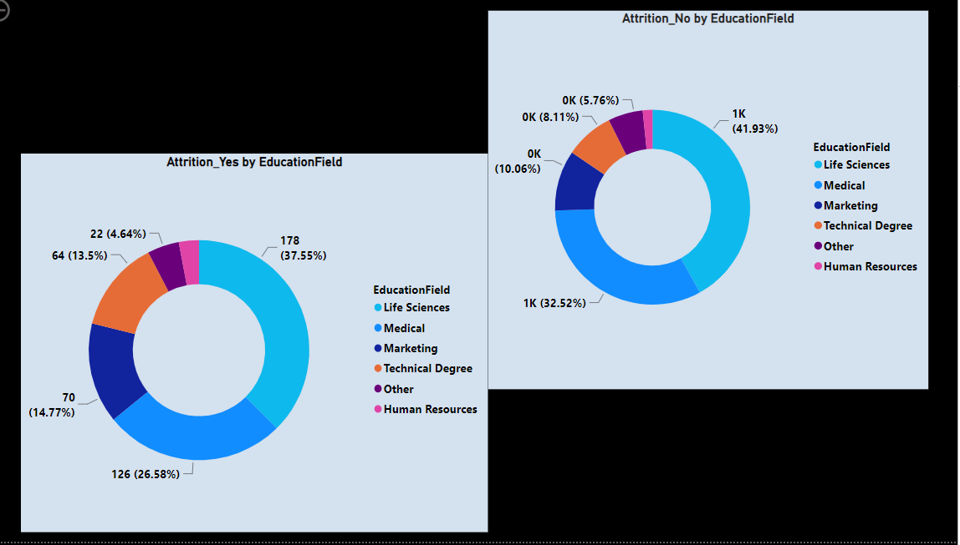
DATA VISUALIZATION

Slide 16
CONCLUSION
Considering what is and what is not accounted for in the models built in this study, their predicting results are fairly accurate.
We used the spark to prepare the data and train different models and compare them in ML and choose the best. We showed how you can use predictive analytics to develop sophisticated models that very accurately detect employees that are at risk of turnover.
The Random Forest Classifier ML algorithm worked well for classifying attrition with accuracy around 0.963718821 on data. With the model predictions, we created graphs in PowerBI that would help any HR manager to retain the best talent by applying the correct strategies. Overall, this is a really useful example where we can see how machine learning and data science can do for your business.
For the future studies, researchers can implement other exciting machine learning methods and compare the results.

Slide 17
THANK YOU…

